Slide 1
Git Version Control
An introduction

Slide 2
Session Overview
What is Version control?
What is Git?
Introducing a repository
Adding files
Staging
Commits
Git push
Git workflow
Merge conflicts

Slide 3
What is Version Control and why should we use it?
Version Control keeps track of our documents and/or code
It allows us to keep track of the changes we make
It allows us to undo things easily
It allows us to share our work with others

Slide 4



What is Git?
Git is an example of Version Control (VC) software
Git differs from other VC systems
Git is the most commonly used VC system
It can be difficult to learn, but it is very powerful
Git works with online hosting services such as GitHub, GitLab and BitBucket

Slide 5
The Git Repository
A repository is a collection of files that belong to a project
The files exist within a named directory
To use Git with a repository, a git.init file must be created within the directory
Version Control can be used to manage the files
The repository can now be shared

Slide 6
Adding files to the repository
A unique directory contains your files
Use the Git command add to start file tracking: git add <filename>
Git “snapshots” any files in their beginning state
Changed files are classed as modified

Slide 7
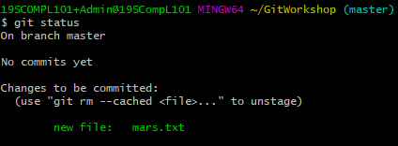
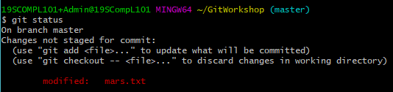
The staging area
Files are added to a staging area
Acts as an intermediary point
View staged files with: git status
Shows newly added files
Shows modified files

Slide 8
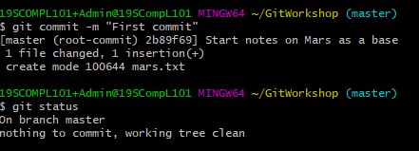
A commit is unique
Commit with a message : git commit -m “First commit”
Once committed, file changes are saved as a snapshot in time
Commits have a unique identifier
‘Working tree clean’
A “clean” working directory is one for which all changes have been committed, while a “dirty” working directory is one that contains changes that have not yet been committed (i.e. recorded/saved).

Slide 9
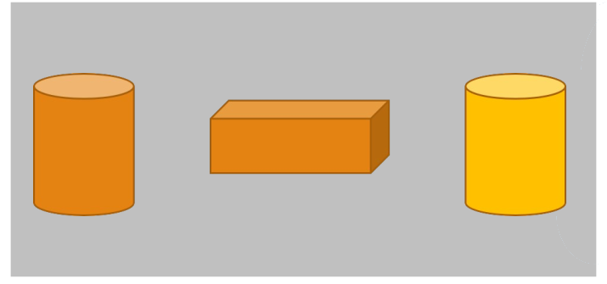
Git workflow
Files are put through a workflow in distinct stages
Files are added to an intermediate staging area : git add mars.txt
Files can then be committed with a message : git commit -m “First commit”
On your computer
Stage to commit to local repository
A directory on your local drive
Local repository

Slide 10
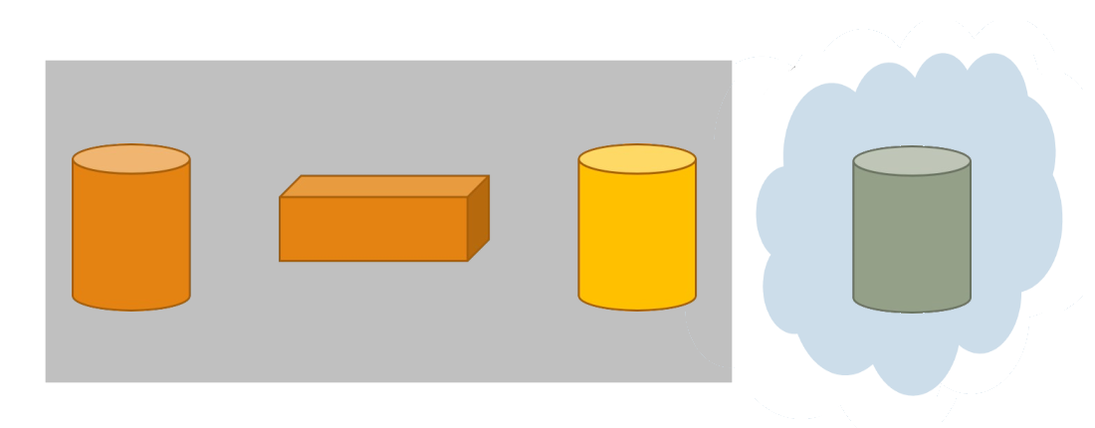
Git push
Files can be pushed to a remote repository : git push
Only committed files are transferred to the remote repository
Files are uploaded to your chosen cloud hosting service
Stage to commit to local repository
Somewhere in the cloud
Remote repository e.g. BitBucket, GitHub, Git Lab
A directory on your local drive
Local repository

